Slide 1
CH-6 MARGINALISATION AND SOCIAL JUSTICE
CIVICS

Slide 2
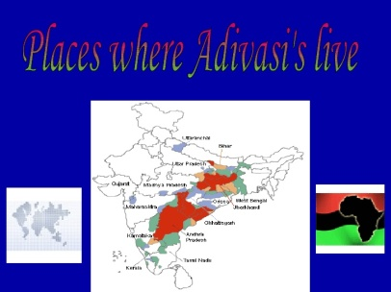
ADIVASI

Slide 3
WHO ARE ADIVASIS?

Slide 5
MINORITIES AND MARGINALISATION

Slide 6
CONSTITUTIONAL AND LEGISLATIVE MEASURES

Slide 14
STATUS OF WOMEN

Slide 17
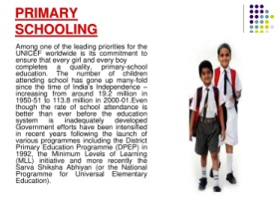

Slide 18
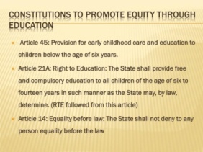

Slide 21
PREPARED BY
KALYANI S

